Slide 1

Infor Storefront Roadmap 2012-2013
Marisa Betancourt, Storefront Product Manager
October 2012

Slide 2
Disclaimer
This announcement reflects the direction Infor may take with regard to the specific product(s) described herein, all of which is subject to change by Infor in its sole discretion, with or without notice to you. This announcement is not a commitment to you in any way and you should not rely on this document or any of its content in making any decision. Infor is not committing to develop or deliver any specified enhancement, upgrade, product or functionality, even if such is described in this announcement and even if such description is accompanied by words such as “anticipate,” “believe,” “expect,” “intend,” “may,” “plan,” “project,” “predict,” “should,” “will,” and/or similar expressions. Many factors can affect Infor’s product development plans and the nature, content and timing of future product releases, all of which remain in the sole discretion of Infor. This announcement, in whole or in part, may not be incorporated into any contractual agreement with Infor or its subsidiaries or affiliates. Infor expressly disclaims any liability with respect to this announcement.

Slide 3
What Have We Been Up To
Secured a Stable 2.0
  Ensured that the performance and stability of the product was SOLID
  Indexing and Migration is a constant focus
2.0.100
  Performance Enhancements
  Improved category navigation
  Cart Flow
  TDCI Channel Sales Integration
  Upgraded to Easy Ask v12
  Upgraded to SQL 2012
  Attributes in Center Pane
  Closed Gaps on Integration to SX.e & A+
3
Copyright © 2010 Infor. All rights reserved.
Notes:
3
Copyright © 2010 Infor. All rights reserved. www.infor.com
Updated Page Layouts with JQ grids but this is for the catalog application only.
Simpler
JS Tree for drag and drop and search field in JS Tree for catalog maintenance.
And user defined fields introduced in 1.5.300

Slide 4
The New UI
Full CSS support
  No more JSP changes needed!
    underlying architecture of UI makes it easier to make changes to the site, HTML 5, div tags
<div id="rightMainColumnPadding">
<jsp:include page="lineitemadd.jsp" flush="true"/>
<jsp:include page="carveOutItems.jsp" flush="true" />
<c:if test="${itemDisplay.nonstock == false}">
<c:set var="showOpenOrdersLink" value="true" />
</c:if>
<jsp:include page="accountbar.jsp" flush="true">
<jsp:param name="showOpenOrdersLink" value="${pageScope.showOpenOrdersLink}" />
<jsp:param name="itemNumber" value="${itemDisplay.itm_num}" />
<jsp:param name="itemDescription" value="${itemDisplay.itm_proddesc}" />
</jsp:include>
<jsp:include page="approvalPanel.jsp" flush="true" />
<jsp:include page="budgetPanel.jsp" flush="true" />
</div>
Ability to change dimensions of logo within css to use on site masthead and on outgoing email notification.
Ability to choose a background, foreground & highlight color.
Ability to customize the labels / text on the site and emails
Notes:
Changing background is part of changing the CSS ort adding your own styling. Instead of changing to each CSS, make the change to the one single css in 2.0
We are now using CSS extensively on JSP. That’s why the changes that designers will have to make will be easier, no more JSP changes needed. (Shakeel needs to elaborate on this when presenting it = DIVS) Every div is a class in the css file.
Created a Global CSS File so that it can used sit-wide.

Slide 5
The New UI
Demonstrations available through PreSales:
  Stephen Knudsen
  Rey Tolentino
  Stacy Guccioni
Examples of Customer Sites
  Inquire with PSO for site references.

Slide 6
A Deeper Look At 2.0.1 Enhancement Packs

Slide 7
Commerce Navigation & Order Info
  Shopping Experience Flow
    The Shopping Cart
      Provide the option for user not to have to go to the cart after every item selection.
    Navigation
      Explorer Bar Left Navigation Menu in Commerce!
        Create ‘Explorer Bar’ folder drill down /navigation for Categories/Subcategories allowing for unlimited drill down on left navigation in Commerce.
    Attribute Search
      Filters for Attributes directly on Main Body- More Directive Selling!
    Images at Subcategory Now Displayed
  Who Placed that Order?
    Allowing Storefront Shopper UserID information to be passed down to the Order Load API
      Your ERP will be subscribing to this and other API Integration Changes in 2013/2014.

Slide 8
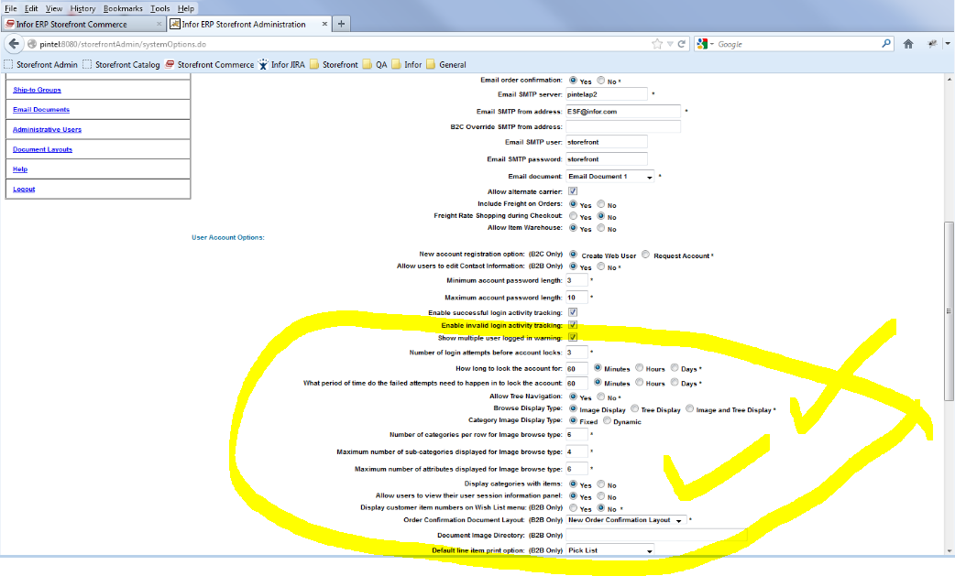
Screen Shots: Admin Settings
Notes:
Admin: This screen shot is showing the different navigation options in the Storefront Admin.

Slide 9
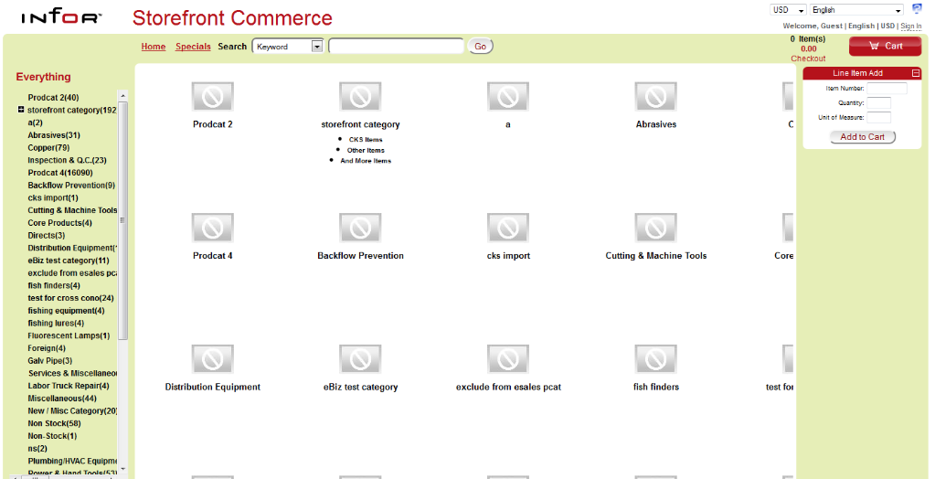
Screen Shots Of Navigation

Slide 10
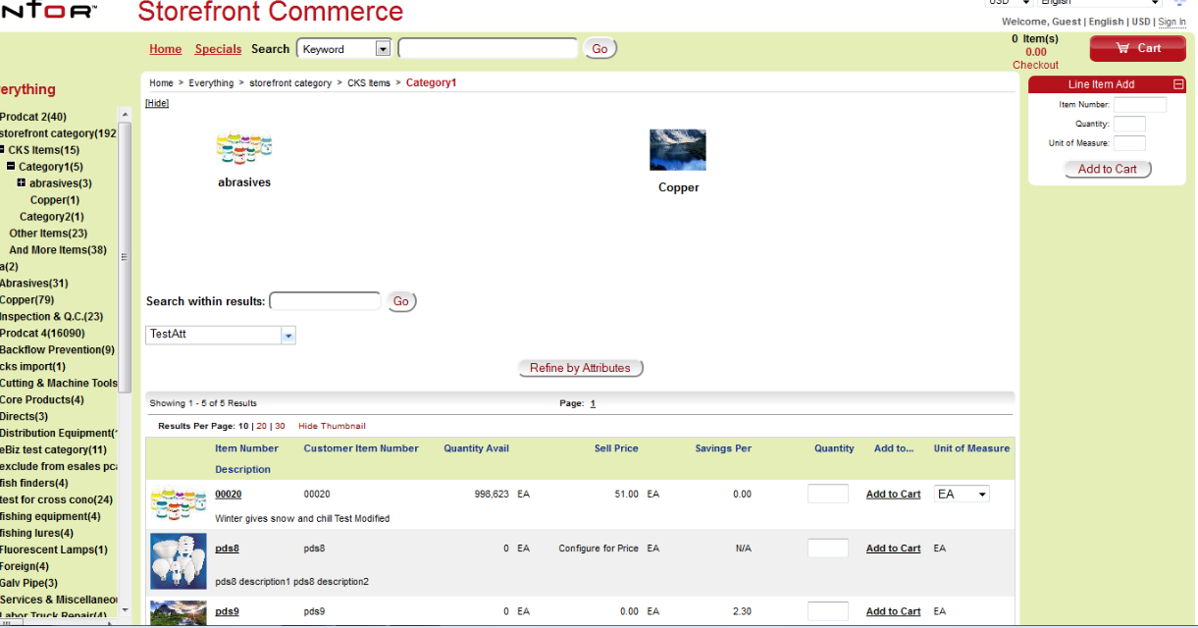
Screen Shots Of Navigation

Slide 11
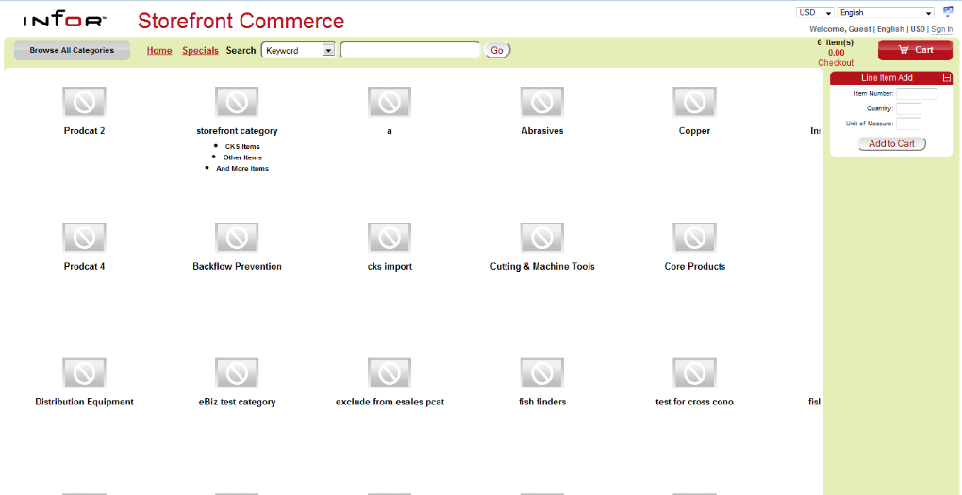
Screen Shots Of Navigation
Notes:
Drilling into a category while in Image Display Mode

Slide 12
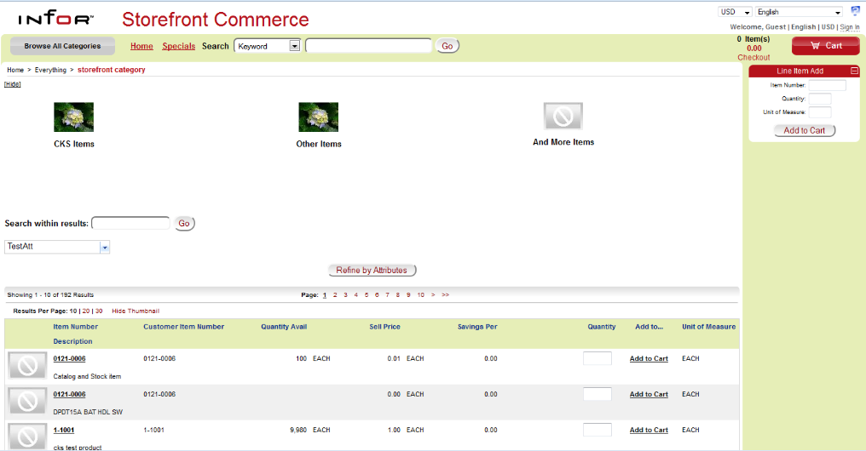
Screen Shots Of Navigation: Image Display
Notes:
Browse Display option set to Image display.

Slide 13
TDCI Channel Sales Integration
  GOAL: Enable User’s of Channel Sales to punch-out to the Standalone Storefront Catalog to select products and bring them back into the TDCI environment for configuration using the new 2.0 UI and Browsing Experience.
    User trigger punch-out from within TDCI Channel Sales
    Users can select both configurable and non-configurable items.
    Configurable items are configured back in TDCI Channel Sales
    Order is submitted through Channel Sales to ERP

Slide 14
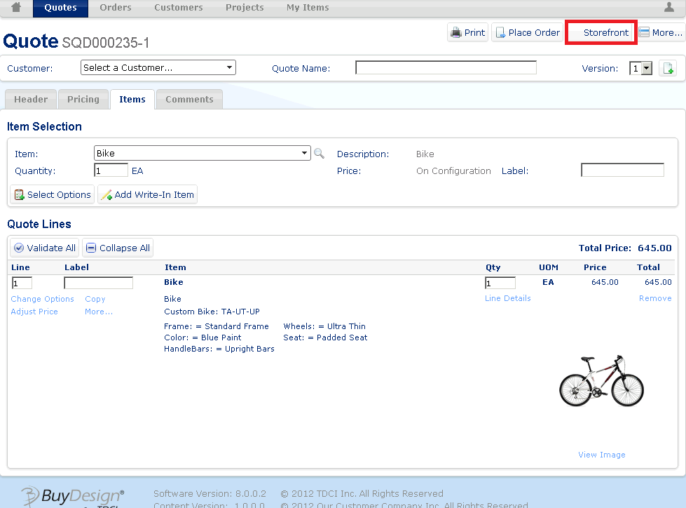
TDCI Channel Sales Integration

Slide 15
Enhanced Performance
  Level II Cache Project – Phase I
    Log In
    Cart
      Price & Availability & Pagination
    Review Orders
    Catalog maintenance
      Revamped the “publishing and indexing” process
  eCommerce Browsing Speed
    Identify architecture and flows that are slowing us down/create improvements
  Scalability Testing began
    Infor testing 1MM Items+ to understand limits and make recommendations/plans to increase scalability.
Notes:
SF Publishing/Indexing Process
- Completely rewritten using Native SQL to maximize database performance
- Reduced the processing time from hours to minutes
- Process is running very stable in 2.0.101
- Hibernate Database Cache
- SF now exploits Hibernate (Database) 2nd level cache for Domain Objects
This caches/ages frequently used database data
to avoid repeated database access for improved performance
- Frequently called Named Database queries were also
rewritten/optimized for improved performance
- Price and Availability calls to Database/ERP
- Database queries were rewritten/optimized to query based on a database view
to reduce repeated database joins and improve performance
- This view based approach reduces the number of queries executed
to determine item availability in warehouses
and displaying details of the items in Storefront Commerce
- Native SQL queries were used wherever possible to improve performance
Order History
- Price and Availability calls on Order History results are only executed against
User requested pages (instead of all the Order History results)
- Requested pages of results are cached;
this dramatically improves paging performance
since all the database access and Price and Availability calls are avoided when
the User requests the same page again
- Browse Page
- SF now contains Account Option “Add item advance to cart".
The user can choose to stay on the browse page while adding items to the cart.
This improves performance/User Shopping experience by:
- Keeping the User on the same page where the Item was added to the Cart
- Avoids repeated database checking/Price and Availability calls
on Items in the Cart on the Cart Page
- Resolves the performance penalty of rendering the Cart Page
as the number of Cart Items increases

Slide 16
Where are We Going
Storefront V 2.0.2 and Beyond

Slide 17
Timeline
Q1 & 2 2012
Q2 2012
Q3+2012
Fix Packs
BUGS
Languages
Channel Sales to SF Integrations
Small Performance Enhancements
2.0.1 Feature Pack
Major Performance Enhancements Phase I
Navigation
  Explorer Bar
  Tree vs. Image
  Cart Flow
  Attribute Filters
ERP Integrations
2.0.2 & Beyond
Performance Enhancements Phase II
Punch-Out
Configurator
SEO Improvements
CenPOS
epaCube
Google Analytics

Slide 18
Punch - Out
What is being offered?
  Storefront Commerce acts as a PunchOut site that provides an electronic catalog that is accessible from a third party purchasing application
  Support for several document types, including:
    Commerce Extensible Markup Language (CXML)
    SAP Open Catalog Interface (OCI)
  Indirect Punch-Out
    User login request sent via XML to Storefront with credentials
    Storefront then sends a connect URL with user session information in a URL to third party
    “Hand Shake”
    More secure than direct punchout

Slide 19
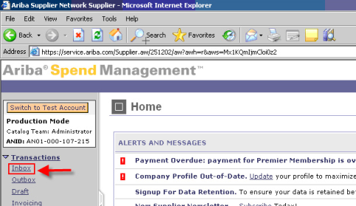
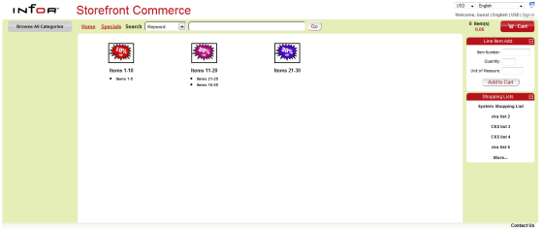

Punch – Out Flow
Third Party
Storefront
Requisition
Storefront
Third Party
Purchase
Order
ERP

Slide 20
Integrations to TDCI Buy Design Configurator
  TDCI
    Storefront Integration → Buy Design Configurator
      Shoppers will be able to shop for and select configurable items
      Shoppers will add configurable items to their cart and trigger configure process from within Cart
      Storefront will punchout to TDCI Buy Design Configurator and enable customer to configure product and obtain real time pricing for the BOD or KIT product.
      When complete, the user will submit the item to Storefront Cart
      Configuration will be repeated for each configurable item.
      Real Time P&A will be executed for the item based on its component at time of Check out.
      Workshop Will run through this in detail.

Slide 21
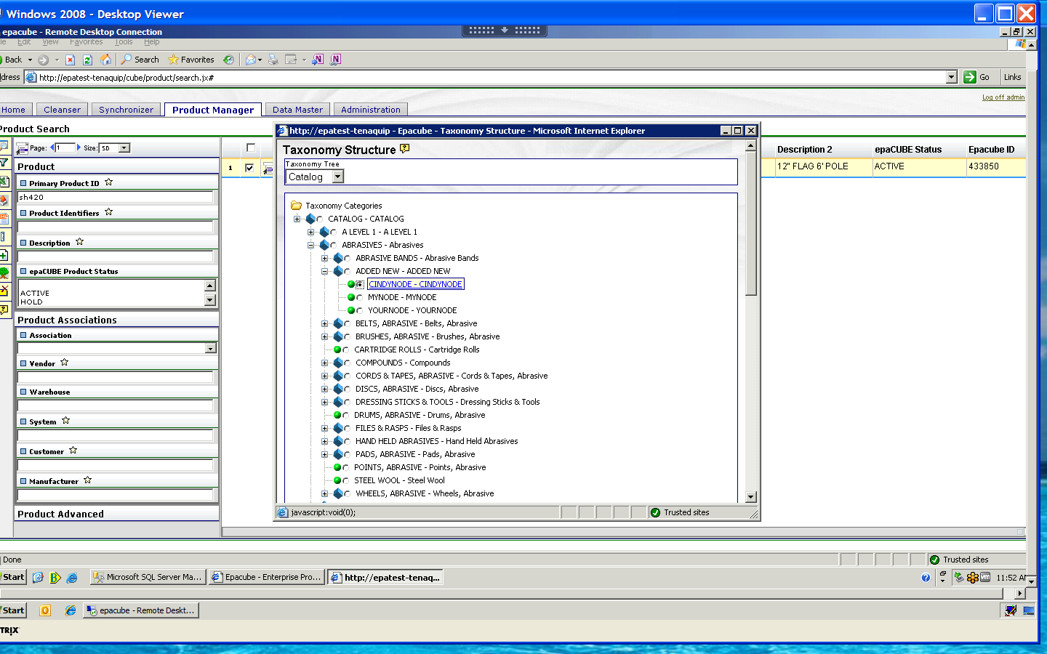
epaCube to Storefront Integration
  epaCube & Group Laurier
    Goal: To enable our distributor customers to enhance “core competency” in Product Data Quality
    Working with Tenaquip
    Structure will now be maintained in one place: epaCube
    Unlimited Category Structure, Rules Sets, Alerts
    Current Storefront customers: One-Time import of data from Storefront or spreadsheet!

Slide 22

CenPOS Integration
Hosted Integration-Tokenization
  Removes Storage of secure card data from within ERP
  Level III Transactions Enabled
  International connections to Canada & Europe established
  SX.e: Target Q4 or 6.1.080
  A+: Target Q4 2012
  Distribution Express: Mid 2013, integration through TCP/IP Manager available today offered through CenPOS

Slide 23
Other New Features in 2.0.200
Enhanced Administrative Functions
  Integration with Google Analytics
Improved User Experience
  Search Engine Optimization (SEO)
    More bot friendly URLs
    Improve Keyword Search/Indexing
    Display images in a grid rather than list- give the user the option to switch

Slide 24
Beyond 2.0.200
Deeper Integrations with Easy Ask
  Strengthening the B2C user experience
    SKU Processing
    SEM- Google Bot Site Mapping and Management
Approvals
  Multi-Level Approvals
Shopping Experience
  Style/Color/Size Matrix
mCommerce
  Web App – available to all smart phones and smart devices
Smaller Enhancements
  Exporting to Excel from eCommerce
  Catalog Import Tool for Non epaCube Users
  Upload Orders
  Order Pad Updates (Validation of UOM)
  UOM and UPC Integrations with ERP
  Promotion Code at Checkout
  Pay with PayPal at Checkout

Slide 25
Currently Planned for 2.0.300
Enhanced Administration
  Admin Application Revamp
    Complete UI Redesign
    Easier User /Account Set Up (Mass Maintenance)
    Shopping List re-architecture
    Ability for Account Reps/CSR to be assigned to User IDs/Accounts
Multi Branding
Budgets & Approvals
  Approver Release of Approved Orders
  Budgets to include ERP Orders
  Multiple Budgets
    Tie to Commodity
    Tie to Ship To’s, etc.
Integration with Infor Social!
  Direct Customer Vendor Link
  Customer Reviews!
  Enable your Workforce to Communicate and be Proactive!

Slide 26
Currently Planned for 2.0.300
Connecting to more Payment Features with CenPOS
  Mobile Payments
  Auto Reconciliation
  Delivery Invoice Images with payment options embedded!
Working with SIG Leaders to prioritize what they would like to see
Encouraging Co-Development Projects with ICS, Partners & Co-Customers

Slide 27
ERP certification with Storefront 2.0.200
Storefront 2.0.200 GA December 18th, 2012
  Infor Distribution SX.e:
    Will work to Certify with 6.1.X
    Will Certify with: TBD
  Infor Distribution A+:
    Currently GA for 8.03.00 and higher
    Will certify to TBD
  Infor Distribution (FACTS):
    Certified with Express v7.7
First Fix Pack for Fixes and Issues 2.0.201
2.0.202 will be a Service pack where Enhancements will be placed. Targeting June 2013

Slide 28
Storefront 2.0 + Roadmap
Thank you for attending! Questions?
Marisa Betancourt, Storefront Product Manager
October 2012

