Slide 1
EPAK
Enterprise Performance Accelerator Kit

Slide 2
Over 1 Million People Use EPAK
Notes:
BAE SYSTEMS (Operations) Ltd
Carrier Corporation
Curtiss Wright Corporation
Frigoglass S.A.I.C.
GKN
Greif Corporation, Inc.
NAVISTAR, Inc.
Progress Rail Services
Sensormatic Electronics Corp
Siemens Medical Instruments Pte Ltd
Solar Turbines Incorporated
Tyco International Management Company

Slide 3
Agenda
Need for documentation
Overcoming the barrier
What is EPAK
EPAK Demonstration

Slide 4
User Adoption & Competency
“The #1 reason for failed implementations”
Source: AMR Research, 2005
Notes:
Users not being ready for go live #1 reason for failed implementations

Slide 5
User Adoption & Competency
“The #1 reason for failed implementations”
Source: AMR Research, 2005
“87% of learning is lost within one month of the training”
Source: Huthwaite study published in American Society for Training & Development Journal
Notes:
Current training methodologies are not effective, most training is lost soon after being delivered

Slide 6
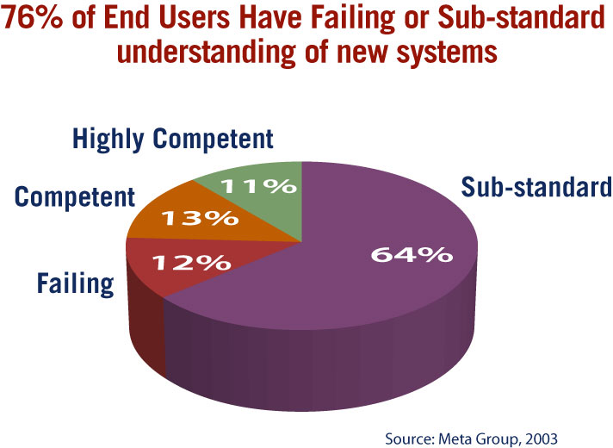
User Adoption & Competency
“The #1 reason for failed implementations”
Source: AMR Research, 2005
“87% of learning is lost within one month of the training”
Source: Huthwaite study published in American Society for Training & Development Journal
Notes:
76% of user are not using systems effectively, what does that cost the business

Slide 7
EPAK – Application Success
Achieve Application Success
Effective
Understanding
Communication
End User Support

Slide 8
Documentation Barrier
 | Traditional Tools
Number of procedures (assumes average complexity) | 100 Procedures
Number of steps to complete procedure (assumes avg complexity) | 20
Number of days to create procedures with 1 full-time employee (includes, development, QA and editing) | 4.5 days per Procedure = 450 days
Web Based Training
On-line help
Student Manuals
Job Aids

Slide 9
EPAK Bridges the Barrier
 | Traditional Tools | EPAK Developer
Number of procedures (assumes average complexity) | 100 Procedures | 100 Procedures
Number of steps to complete procedure (assumes avg complexity) | 20 | 20
Number of days to create procedures with 1 full-time employee (includes, development, QA and editing) | 4.5 days per Procedure = 450 days | .75 day per procedure=75 days
Web Based Training
On-line help
Student Manuals
Job Aids

Slide 10
EPAK is..
A desktop application
Simple to use
Documents business processes 10 - 30 times faster
Is a complete documentation solution
14 outputs – application lifecycle
Consistent documentation across all outputs
Allows you to reap the benefits of documentation
Overcomes the barrier to creating documentation

Slide 11
EPAK Demo
DEMO

Slide 12
Mitigates Project Risk and Increase Success
Better understanding
Better communication
Better extended team coordination
Consistent documentation
Support users
Effective end user training
Validate user readiness
Post go live support
Reduced Project Risk
Increased Project Success

